Slide 1
Talk
About NOC communication
Problem definition and solution(s)
Thomas Mangin – LINX 97 – 20th and 21st February

Slide 2
Peering session down !
Is it normal ? Did you expect it ?
When should you expect it back?
Outage ? Maintenance ? De-peering ?
Maintenance notification “problem”
781 networks at LINX
Lots of maintenance notifications (or not !)
All per e-mail, with every IX having its own mailing list ..

Slide 3
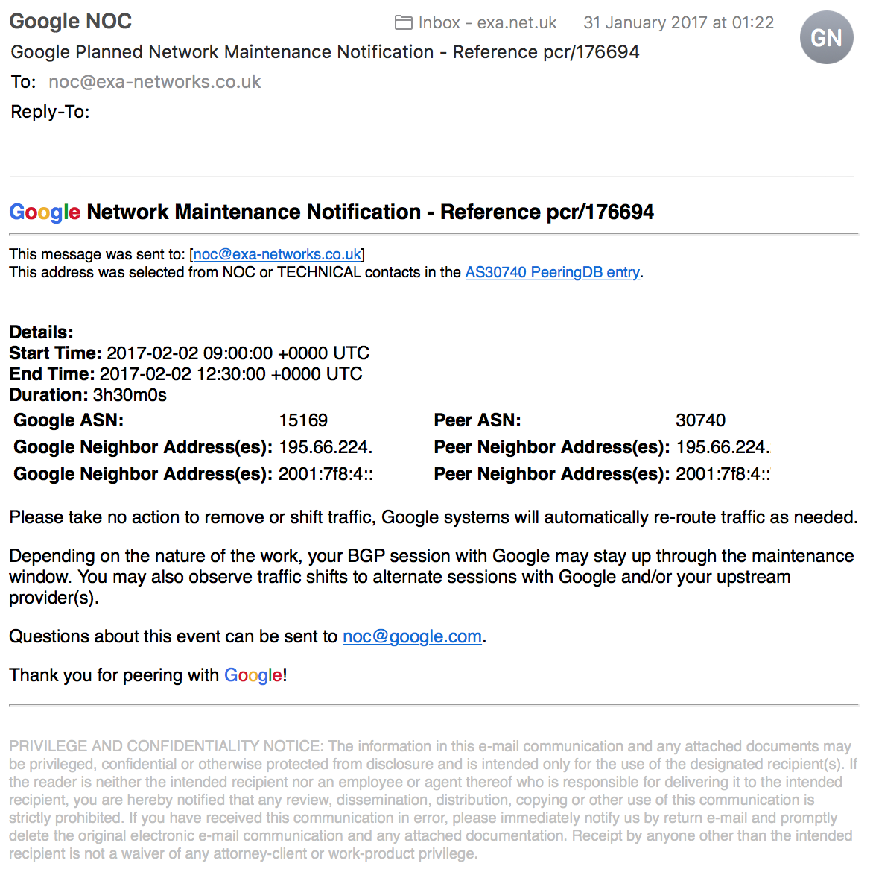
You are Lucky
You dig that “state of art” mail
… from two days/weeks ago
… lost in the ticket system
… could you machine parse it?
You are Unlucky
You use peeringdb.com
… email your peer
... and wait
… none the wiser

Slide 4
Can IXes
… provide better way for us to e-mail maintenance (yes*)
… help define a structured format for maintenances
... integrate both within their portal
Or should PeeringDB (or Euro-IX, or …)
… provide maintenance notification
… and all of the above (working with IXes)
In the meanwhile …
* only sending mails to your peers, finding peering relation by looking for port 179 traffic at the IX

Slide 5
in task force not that far far away …
BGP
SHUTDOWN
COMMUNICATION
DRAFT
https://tools.ietf.org/html/draft-ietf-idr-shutdown-05

Slide 6
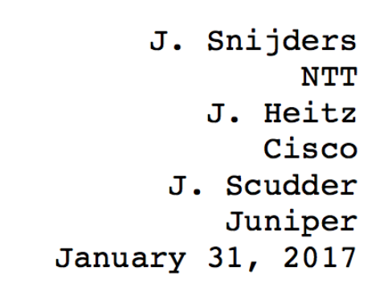
To read with the voice over of (in your mind)
AFTER
draft-ietf-idr-large-community-12 (RFC 8092 since 16/02)
Job Snijders strikes again
WITH
draft-ietf-idr-shutdown-05

Slide 7
draft-ietf-idr-shutdown-05
An extension to the BGP shutdown NOTIFICATION message,
Providing a short 128 characters twitter like messages (to prevent forgeries in logs)
To provide information about the reason why a peer may have gone away,
or slightly less if you decide to use some UTF-8 encoding
NOT twitter over BGP
Unless you like to bounce sessions

Slide 8
draft-ietf-idr-shutdown-05
What changes?
0 1 2 3
0 1 2 3 4 5 6 7 8 9 0 1 2 3 4 5 6 7 8 9 0 1 2 3 4 5 6 7 8 9 0 1
+-+-+-+-+-+-+-+-+-+-+-+-+-+-+-+-+-+-+-+-+-+-+-+-+-+-+-+-+-+-+-+-+
| Error code | Error subcode | Data (variable) |
+-+-+-+-+-+-+-+-+-+-+-+-+-+-+-+-+-+-+-+-+-+-+-+-+-+-+-+-+-+-+-+-+
becomes
+-+-+-+-+-+-+-+-+-+-+-+-+-+-+-+-+-+-+-+-+-+-+-+-+-+-+-+-+-+-+-+-+
| Error code 6 | Subcode | Length | ... \
+-+-+-+-+-+-+-+-+-+-+-+-+-+-+-+-+-+-+-+-+-+-+-+-+ /
\ \
/ ... Shutdown Communication ... /
\ \
+-+-+-+-+-+-+-+-+-+-+-+-+-+-+-+-+-+-+-+-+-+-+-+-+-+-+-+-+-+-+-+-+

Slide 9
Network does
> bgpctl neighbor 165.254.255.24 down \
"[TICKET-REF] we are upgrading the RE, be back in 30 minutes, do not CALL the NOC please 😜”
Peer sees
Jan 8 19:28:54 shutdown bgpd[50719]: neighbor 165.254.255.26: received notification: Cease, administratively down
Jan 8 19:28:54 shutdown bgpd[50719]: neighbor 165.254.255.26: received shutdown reason:"[TICKET-REF] we are upgrading the RE, be back in 30 minutes, do not CALL the NOC please 😜"

Slide 10
WHAT NEXT ?
Implementations ..
EXABGP
Merci, Job Snijders!
GOBGP
Thank you Iwase YUSUKE, and NTT Labs!
OPENBGPD
Thank you, Peter van Dijk
& the PowerDNS team!
PMACCT
Thank you, Paolo Lucente
WIRESHARK
Thank you, Arjen Zonneveld
(in IETF Last Call)
Tell your vendor if you want it
Implementation is T.R.I.V.I.A.L !

Slide 11
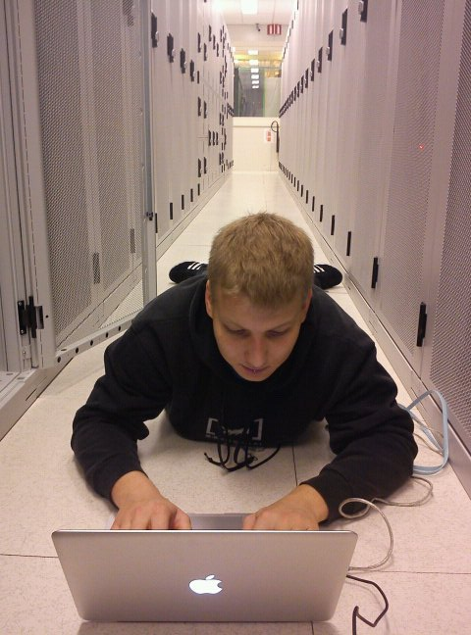
Questions ?
Who said he was thinking about photoshopping a superman cape ?

