Slide 1
Talk
Presented at lightning speed
Thomas Mangin – LINX 95 - 21st and 22nd November

Slide 2
BGP LARGE
COMMUNITY
DRAFT
https://tools.ietf.org/html/draft-heitz-idr-large-community-08

Slide 3
NINE years ago at LINX 57
http://thomas.mangin.com/data/pdf/LINX 57- Mangin - Leak presentation.pdf
Still relevant today …
Among other things, recommend “community filtering”
- tags routes on eBGP inbound (from transit, peer, etc)
- filter on eBGP outbound (no transit routes for peer)
But only if you have a 16 bits ASN
Otherwise sorry: you are doomed...
And you have have been since RFC 4893 in 2007...
TEN years ago

Slide 4
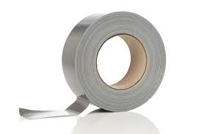
Previous attempts to fix the issue
(and feature creep)
Name | Year | Code | Method | Usable size | Document
RFC 1997 | 1996 | 8 | Opaque | 32 bits | 5 pages
RFC 4360 | 2006 | 16 | Structure | 48 bits (64-16) | 12 pages
RFC 5668 | 2009 | 16 | Structure | 48 bits | 5 pages (define RFC 4360)
drah-lange-flexible-bgp-communities | 2002-2010 | TBD | TLV | BIG | 21 pages
draft-raszuk-wide-bgp-communities | 2015-2016 | TBD | TLV | BIG | 26 pages
Complex, no consensus
never implemented

Slide 5
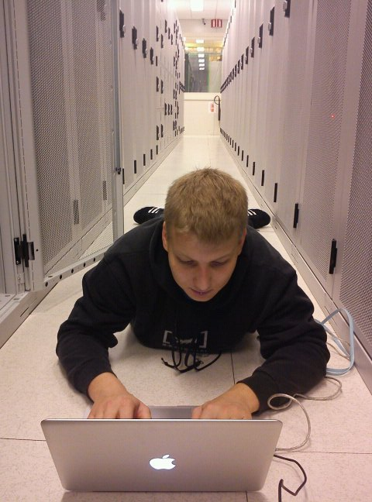
draft-ietf-idr-large-community-08
Like RFC 1997 .. but larger and
SIMPLE (from 6, to 8 and now 9 pages)
96bits space (3x 32 bits)
Started September 2016
IANA allocated attribute code 32
Another draft proposing how to use the space
draft-snijders-grow-large-communities-usage-00
0 1 2 3
0 1 2 3 4 5 6 7 8 9 0 1 2 3 4 5 6 7 8 9 0 1 2 3 4 5 6 7 8 9 0 1
+-+-+-+-+-+-+-+-+-+-+-+-+-+-+-+-+-+-+-+-+-+-+-+-+-+-+-+-+-+-+-+-+
| Autonomous System Number |
+-+-+-+-+-+-+-+-+-+-+-+-+-+-+-+-+-+-+-+-+-+-+-+-+-+-+-+-+-+-+-+-+
| Local Data Part 1 |
+-+-+-+-+-+-+-+-+-+-+-+-+-+-+-+-+-+-+-+-+-+-+-+-+-+-+-+-+-+-+-+-+
| Local Data Part 2 |
+-+-+-+-+-+-+-+-+-+-+-+-+-+-+-+-+-+-+-+-+-+-+-+-+-+-+-+-+-+-+-+-+

Slide 6
When ?

Slide 7
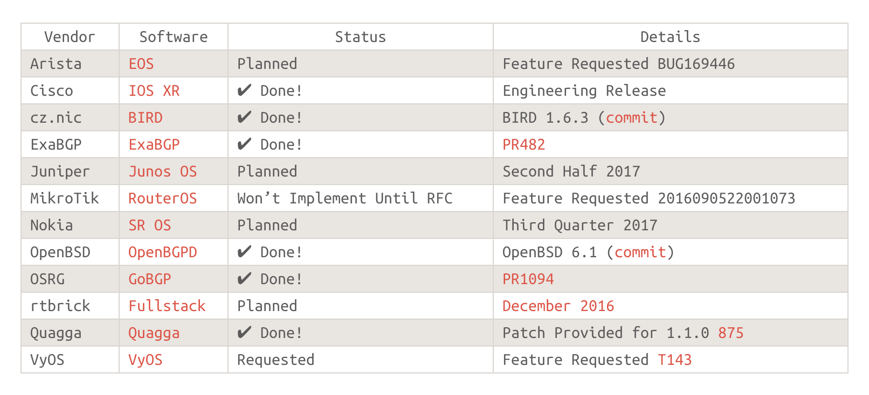
BGP LARGE
COMMUNITIES
Implementations ..
FIRST OSS IMPLEMENTATION
COMPLETE patch by JOB

Slide 8
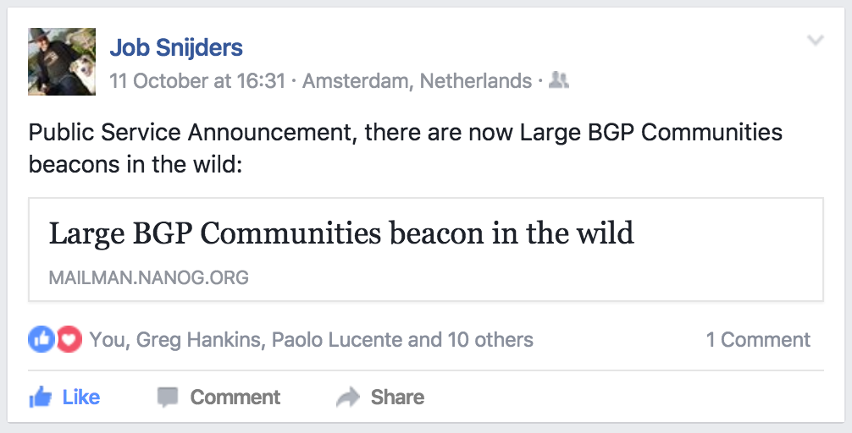

Slide 9
Credits:
http://largebgpcommunities.net/
all you need to know is there !
Thank you:
https://github.com/pierky/bgp-large-communities-playground
And everyone who supported the draft on the IETF mailing list
(You know who you are – beers are on me Tuesday)

